Slide 1
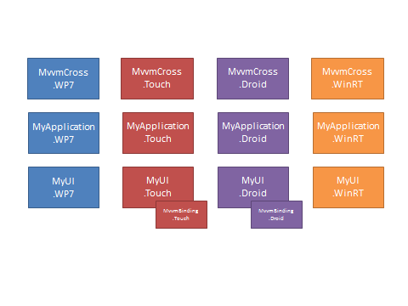
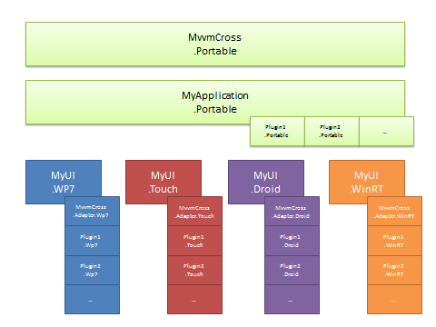
MvvmCross – Going Portable
Going Portable
@slodge

Slide 2
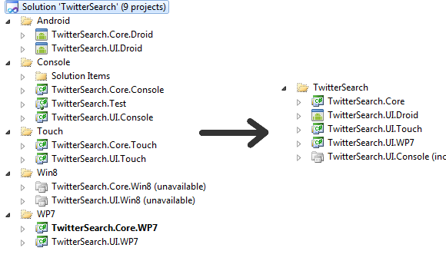
The key picture…

Slide 3
MvvmCross
Version 1

Slide 4
MvvmCross
.WP7
MvvmCross
.Touch
MvvmCross
.Droid
MvvmCross
.WinRT
MyApplication
.WP7
MyApplication
.Touch
MyApplication
.Droid
MyApplication
.WinRT
MyUI
.WP7
MyUI
.Touch
MyUI
.Droid
MyUI
.WinRT
MvvmBinding
.Touch
MvvmBinding
.Droid

Slide 5
MvvmCross
.WP7
MvvmCross
.Touch
MvvmCross
.Droid
MvvmCross
.WinRT
M
MyApplication
.WP7
MyApplication
.Touch
MyApplication
.Droid
MyApplication
.WinRT
Core MvvmCross Library contains:
Mvvm interfaces and base classes
Simple DI container and IoC controller
Platform specific navigation and presentation logic
Platform specific implementations of file, location, camera, etc
MyUI
.WP7
MyUI
.Touch
MyUI
.Droid
MyUI
.WinRT
MvvmBinding
.Touch
MvvmBinding
.Droid

Slide 6
M
MvvmCross
.WP7
MvvmCross
.Touch
MvvmCross
.Droid
MvvmCross
.WinRT
MyApplication
.WP7
MyApplication
.Touch
MyApplication
.Droid
MyApplication
.WinRT
M
MyUI
.WP7
MyUI
.Touch
MyUI
.Droid
MyUI
.WinRT
MyApplication Library contains:
Application startup logic
Models and Services
ViewModels
ValueConverters
Identical code across platforms – just cut-and-paste projects
MvvmBinding
.Touch
MvvmBinding
.Droid

Slide 7
M
MvvmCross
.WP7
MvvmCross
.Touch
MvvmCross
.Droid
MvvmCross
.WinRT
MyUI Executable contains:
Platform Specific Views and Controls
Some adaption for ValueConverters
MyApplication
.WP7
MyApplication
.Touch
MyApplication
.Droid
MyApplication
.WinRT
MyUI
.WP7
MyUI
.Touch
MyUI
.Droid
MyUI
.WinRT
MvvmBinding
.Touch
MvvmBinding
.Droid

Slide 8
Problems
MvvmCross is a “fat” library – contains more than just mvvm!
Compiled image sizes can be large – especially on MonoTouch
Application libraries are cut and paste – a boring, error prone manual job
Automated cross-platform refactoring is impossible
No common way to extend the platform
Each new platform added requires manual cut-and-paste duplication of projects

Slide 9
MvvmCross
Version Next

Slide 10
MvvmCross
.Portable
MyApplication
.Portable
Plugin1
.Portable
Plugin2
.Portable
…
MyUI
.WP7
MyUI
.Touch
MyUI
.Droid
MyUI
.WinRT
MvvmCross
.Adapter.Wp7
MvvmCross
.Adapter.Touch
MvvmCross
.Adapter.Droid
MvvmCross
.Adapter.WinRT
Plugin1
.Wp7
Plugin1
.Touch
Plugin1
.Droid
Plugin1
.WinRT
Plugin2
.Wp7
Plugin2
.Touch
Plugin2
.Droid
Plugin2
.WinRT
…
…
…
…

Slide 11
MvvmCross
.Portable
M
MyApplication
.Portable
MvvmCross is a single Portable library containing:
Mvvm base classes
Simple DI container and IoC controller
Plugin Loader base interfaces
Plugin1
.Portable
Plugin2
.Portable
…
MyUI
.WP7
MyUI
.Touch
MyUI
.Droid
MyUI
.WinRT
MvvmCross
.Adapter.Wp7
MvvmCross
.Adapter.Touch
MvvmCross
.Adapter.Droid
MvvmCross
.Adapter.WinRT
Plugin1
.Wp7
Plugin1
.Touch
Plugin1
.Droid
Plugin1
.WinRT
Plugin2
.Wp7
Plugin2
.Touch
Plugin2
.Droid
Plugin2
.WinRT
…
…
…
…

Slide 12
M
MvvmCross
.Portable
MyApplication
.Portable
M
Plugin1
.Portable
Plugin2
.Portable
…
MyUI
.WP7
MyUI
.Touch
MyUI
.Droid
MyUI
.WinRT
MyApplication is a single Portable library containing:
Application startup logic
Models and Services
ViewModels
ValueConverters
MvvmCross
.Adapter.Wp7
MvvmCross
.Adapter.Touch
MvvmCross
.Adapter.Droid
MvvmCross
.Adapter.WinRT
Plugin1
.Wp7
Plugin1
.Touch
Plugin1
.Droid
Plugin1
.WinRT
Plugin2
.Wp7
Plugin2
.Touch
Plugin2
.Droid
Plugin2
.WinRT
…
…
…
…

Slide 13
M
MvvmCross
.Portable
M
MyApplication
.Portable
Plugin1
.Portable
Plugin2
.Portable
…
MyUI
.WP7
MyUI
.Touch
MyUI
.Droid
MyUI
.WinRT
The Portable part of each Plugin:
Provides the interface for that plugin
e.g. for Location it provides Start, Stop, and an OnLocationChanged event.
Provides an EnsureLoaded() call for initialisation at runtime
MvvmCross
.Adapter.Wp7
MvvmCross
.Adapter.Touch
MvvmCross
.Adapter.Droid
MvvmCross
.Adapter.WinRT
Plugin1
.Wp7
Plugin1
.Touch
Plugin1
.Droid
Plugin1
.WinRT
Plugin2
.Wp7
Plugin2
.Touch
Plugin2
.Droid
Plugin2
.WinRT
…
…
…
…

Slide 14
M
MvvmCross
.Portable
MyUI executable provides:
Platform Specific Views and Controls
Some adaption for ValueConverters
MyApplication
.Portable
Plugin1
.Portable
Plugin2
.Portable
…
MyUI
.WP7
MyUI
.Touch
MyUI
.Droid
MyUI
.WinRT
MvvmCross
.Adapter.Wp7
MvvmCross
.Adapter.Touch
MvvmCross
.Adapter.Droid
MvvmCross
.Adapter.WinRT
Plugin1
.Wp7
Plugin1
.Touch
Plugin1
.Droid
Plugin1
.WinRT
Plugin2
.Wp7
Plugin2
.Touch
Plugin2
.Droid
Plugin2
.WinRT
…
…
…
…

Slide 15
M
MvvmCross
.Portable
The MvvmCross.Adapter for each platform provides:
Platform Specific Mvvm Helpers – e.g. binding
Platform Specific View and navigation
Platform Specific Plugin Manager/Loader
MyApplication
.Portable
Plugin1
.Portable
Plugin2
.Portable
…
MyUI
.WP7
MyUI
.Touch
MyUI
.Droid
MyUI
.WinRT
MvvmCross
.Adapter.Wp7
MvvmCross
.Adapter.Touch
MvvmCross
.Adapter.Droid
MvvmCross
.Adapter.WinRT
Plugin1
.Wp7
Plugin1
.Touch
Plugin1
.Droid
Plugin1
.WinRT
Plugin2
.Wp7
Plugin2
.Touch
Plugin2
.Droid
Plugin2
.WinRT
…
…
…
…

Slide 16
M
MvvmCross
.Portable
Plugin Implementations:
Provide platform specific implementations of each Plugin Interface
e.g. for Location a platform specific service will provide Start, Stop, and OnLocationChanged.
Are initialised at runtime using a mixture of:
Project references
Convention-based dynamic assembly loading
Setup Helpers on platforms that don’t support Assembly.Load()
MyApplication
.Portable
Plugin1
.Portable
Plugin2
.Portable
…
MyUI
.WP7
MyUI
.Touch
MyUI
.Droid
MyUI
.WinRT
MvvmCross
.Adapter.Wp7
MvvmCross
.Adapter.Touch
MvvmCross
.Adapter.Droid
MvvmCross
.Adapter.WinRT
Plugin1
.Wp7
Plugin1
.Touch
Plugin1
.Droid
Plugin1
.WinRT
Plugin2
.Wp7
Plugin2
.Touch
Plugin2
.Droid
Plugin2
.WinRT
…
…
…
…

Slide 17
Plugins – Portable Interfaces
In the Portable Library – Plugins.Email.dll:
public interface IMvxComposeEmailTask
{
void ComposeEmail(string to, string cc, string subject, string body, bool isHtml);
}
public class PluginLoader
: IMvxPluginLoader
, IMvxServiceConsumer<IMvxPluginManager>
{
public static readonly PluginLoader Instance = new PluginLoader();
#region Implementation of IMvxPluginLoader
public void EnsureLoaded()
{
var manager = this.GetService<IMvxPluginManager>();
manager.EnsureLoaded<PluginLoader>();
}
#endregion
}

Slide 18
Plugins – Portable Use
The plugin can be used in a Portable ViewModel as simply as:
protected void ComposeEmail(string to, string subject, string body)
{
Cirrious.MvvmCross.Plugins.Email.PluginLoader.Instance.EnsureLoaded();
var task = this.GetService<IMvxComposeEmailTask>();
task.ComposeEmail(to, null, subject, body, false);
}

Slide 19
Plugins – Platform Specific Implementations
In one platform specific implementation – Plugins.Email.WindowsPhone.dll:
public class MvxComposeEmailTask : MvxWindowsPhoneTask, IMvxComposeEmailTask
{
public void ComposeEmail(string to, string cc, string subject, string body, bool isHtml)
{
var task = new EmailComposeTask() { To = to, Subject = subject, Cc = cc, Body = body };
DoWithInvalidOperationProtection(task.Show);
}
}
public class Plugin
: IMvxPlugin
, IMvxServiceProducer<IMvxComposeEmailTask>
{
#region Implementation of IMvxPlugin
public void Load()
{
this.RegisterServiceType<IMvxComposeEmailTask, MvxComposeEmailTask>();
}
#endregion
}

Slide 20
Advantages
Core MvvmCross is now a much smaller library
Compiled image sizes can be much smaller – especially on MonoTouch
Each Application is now a single library
Cross-platform refactoring now a reality
Manual cut-and-paste between projects eliminated
Plugin technique allows easy extensibility for everyone
New portable architecture makes it easier to add and support new platforms – Silverlight, WPF, MonoMac, PlayStationSuite, …

Slide 21
The key picture…

Slide 22
Progress…
Working now:
WP7
Mono for Android
WinRT
In progress:
MonoTouch

